Slide 1


SPACE COORDINATES AND SURFACES
Math 14
Plane and Solid Analytic Geometry

Slide 2
OBJECTIVES:
At the end of the lesson, the student is expected to be able to:
• define space coordinates.
• plot points of space coordinates.
• write and sketch the graphs of space coordinate
equations.
• know the different kinds planes and surfaces.

Slide 3
Let OX, OY, and OZ be three mutually perpendicular lines. These lines constitute the x-axis, the y-axis, and the z-axis of a three-dimensional rectangular coordinate system. The axes, in pairs, determine three mutually perpendicular planes called coordinate planes. The planes are designated as the XOY-plane, the XOZ-plane, and the YOZ-plane or, more simply, the xy-plane, the xz-plane, and the yz-plane. The coordinate planes divide space into eight regions called octants. The distance of P from the yz-plane is called the x-coordinate, the distance from the xz-plane the y-coordinate, and the distance from the xy-plane the z-coordinate. The coordinates of a point are written in the form (x, y, z), in this order, x first, y second, and z third.

Slide 4
z
xz-plane
yz-plane
o
xy-plane
x
y

Slide 5
Example:
Plot the given points in a three-dimensional coordinate system.
(3, 0, 0)
(0, 3, 0)
(0, 0, 3)
(1.5,-1, 2)
(0, 2, -2)
(2, 2.5, 3)

Slide 6


z
-x
(0, 0, 3)
(2, 2.5, 3)
(1.5,-1, 2)
(0, 3, 0)
-y
y
o
(3, 0, 0)
(0, 2, -2)
x
-z

Slide 7
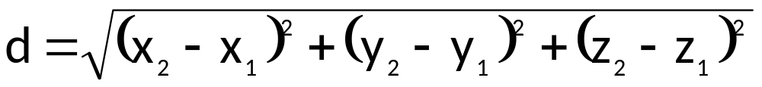
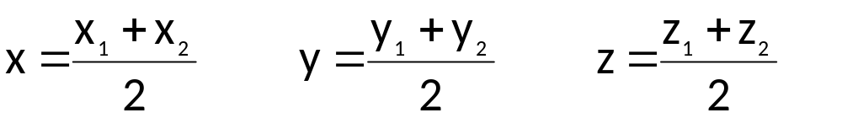
THEOREMS:
Let P₁(x₁, y₁, z₁) and P₂(x₂, y₂, z₂) be the coordinates of two points in a three-dimensional coordinate system. Then the distance d between P₁ and P₂ is given by
The coordinates P(x, y, z) of the midpoint of the line segment joining P₁(x₁, y₁, z₁) and P₂(x₂, y₂, z₂) are given by the equations
This theorem may be generalized by letting P(x, y, z) be any division point of the line through P₁ and P₂. If the ratio of P₁P to P₁P₂ is a number r, then

Slide 8
EXAMPLES:
1. Find the distance between the points P₁(-4, 4, 1) and P₂(-3, 5,-4).
2. Find the coordinates of the midpoint of the line segment that joins A(3,-2, 4) and B(-6, 5, 8).
3. Find the coordinates of the point P(x, y, z), which is one-third of the way from A(1, 3, 5) to B(5, 7, 9).
4. Given: A(1, 4, 7) and B(5,-1, 11), find the point P so that the ratio of AP to PB is equal to 4 to 7.

Slide 9
SURFACES
PLANE: Ax + By + Cz + D = 0
a) x = k, plane parallel to yz-plane
b) y = k, plane parallel to xz-plane
c) z = k, plane parallel to xy-plane
d) Ax + By + D = 0, plane parallel to z-axis
e) By + Cz + D = 0, plane parallel to x-axis
f) Ax + Cz + D = 0, plane parallel to y-axis
g) Ax + By + Cz = 0, plane

Slide 10
EXAMPLE:
1. x = 3 2. y = 3
z
z
y
y
x
x

Slide 11
3. z = 3
4. 2x + 3y = 12
z
z
(0, 4, 0)
y
y
x
x
(6, 0, 0)

Slide 12
5. 2x + 3z = 12
6. 2y + 3z = 12
z
z
(0, 0, 4)
(0, 0, 4)
(0, 6, 0)
y
y
(6, 0, 0)
x
x

Slide 13
6. 2x + 3y + 4z = 12
z
(0, 0, 3)
(0, 4, 0)
y
(6, 0, 0)
x

Slide 14

CYLINDERS and SPHERE:
1. x² + y² = 4
z
(-2, 0, 0)
(0, 2, 0)
y
(0,-2, 0)
(2, 0, 0)
CIRCULAR CYLINDER
x

Slide 15
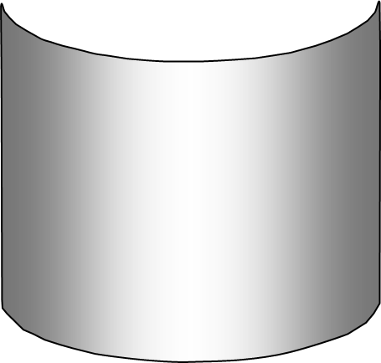
2. 4x² + y² = 4
z
(-1, 0, 0)
(0, 2, 0)
y
(0,-2, 0)
(1, 0, 0)
ELLIPTICAL CYLINDER
x

Slide 16
3. x² = y
z
y
x

Slide 17
4. y² = x
z
y
x

Slide 18
5. z² = y
z
y
x

Slide 19
5. z² = y – 1
z
y
V(0, 1, 0)
x

Slide 20
SPHERE: (x – h)² + (y – k)² + (z – l)² = r²
Ax² + Ay² + Az² + Gx + Hy + Iz = J
r = 0 (point)
r = - (no locus)
r = + (sphere)
z
y
x

Slide 21
EXAMPLE:
Describe the locus of x² + y² + z² + 2x – 4y – 8z + 5 = 0. Sketch the graph.
SOLUTION:
x² + 2x + 1 + y² – 4y + 4 + z² – 8z + 16 = –5 + 1 + 4 + 16
(x + 1)² + (y – 2)² + (z – 4)² = 16
C(–1, 2, 4) and r = 4

Slide 22
z’
(-1, 2, 8)
(-5, 2, 4)
z
(-1, 6, 4)
y’
(-1,- 2, 4)
C(-1, 2, 4)
(3, 2, 4)
x’
(-1, 2, 0)
y
x

Slide 23
QUADRIC SURFACES
Second-Degree Equation in x, y, z
Form: Ax²+By²+Cz²+Dxy+Exz+Fyz+Gx+Hy+Iz+J=0
The graph of such equation is called quadric surface or simply quadric.
Six Common Types of Quadric Surfaces:
Ellipsoid
Hyperboloid of One Sheet
Hyperboloid of Two Sheets
Elliptic Paraboloid
Hyperbolic Paraboloid
Elliptic Cone

Slide 24
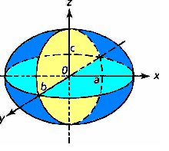
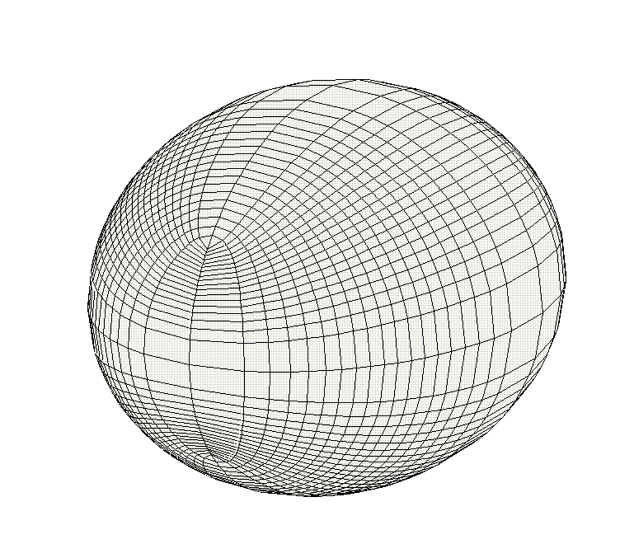
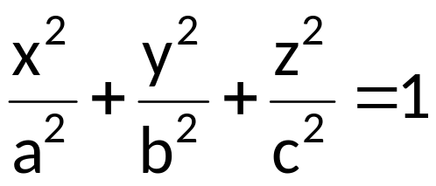
QUADRIC SURFACES
y
x
ELLIPSOID

Slide 25
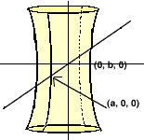
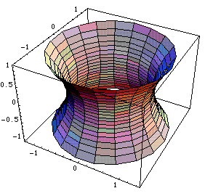
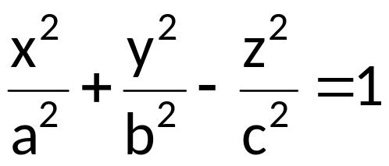
QUADRIC SURFACES
HYPERBOLOID OF ONE SHEET

Slide 26
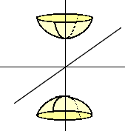
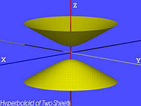
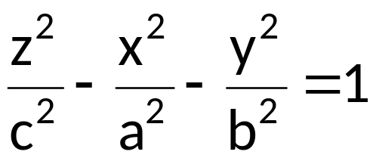
QUADRIC SURFACES
HYPERBOLOID OF TWO SHEETS

Slide 27
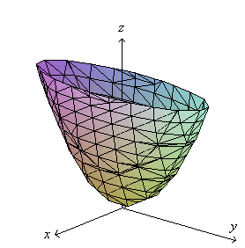
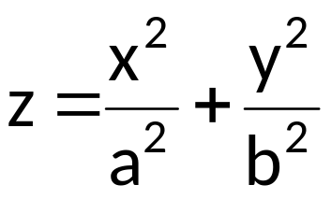
QUADRIC SURFACES
ELLIPTIC PARABOLOID

Slide 28
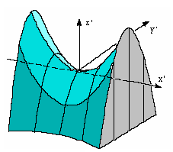
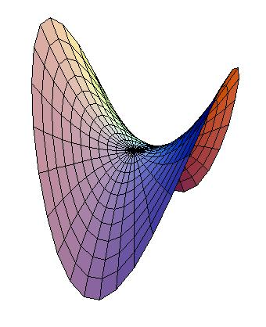
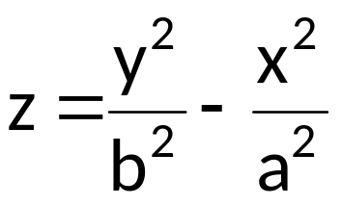
QUADRIC SURFACES
z’
x’
y’
HYPERBOLIC PARABOLOID

Slide 29
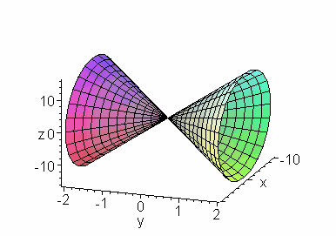
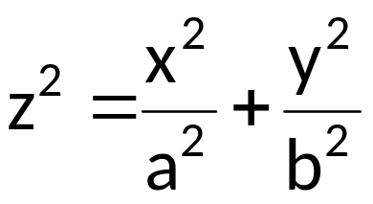
QUADRIC SURFACES
ELLIPTIC CONE

Slide 30
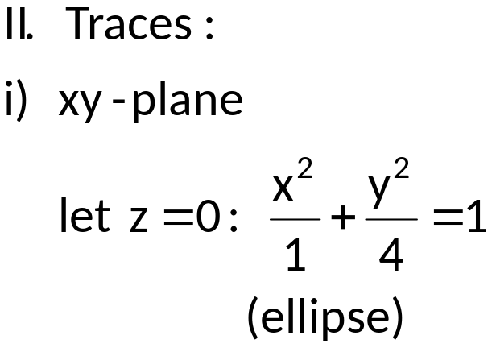
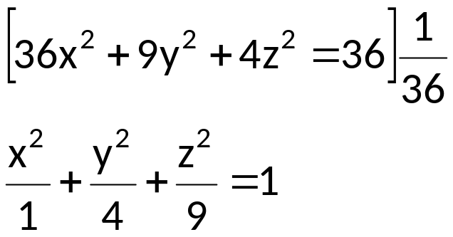
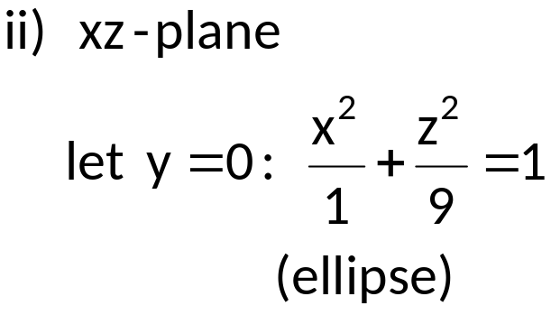

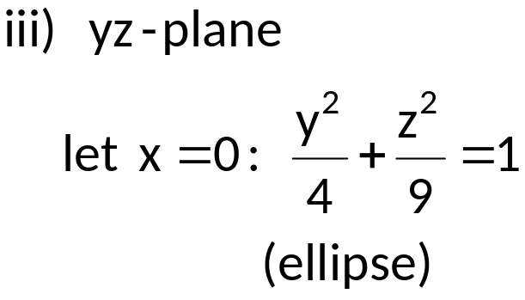
EXAMPLES: Sketch the quadric surface.
36x²+9y²+4z²=36
Solution:
 | x | y | z
x | ±1 | 0 | 0
y | 0 | ±2 | 0
z | 0 | 0 | ±3

Slide 31
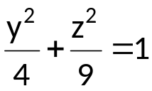
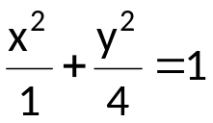


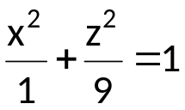
z
(0,0,3)
(-1,0,0)
(0,-2,0)
(0,2,0)
y
(1,0,0)
(0,0,-3)
x

Slide 32
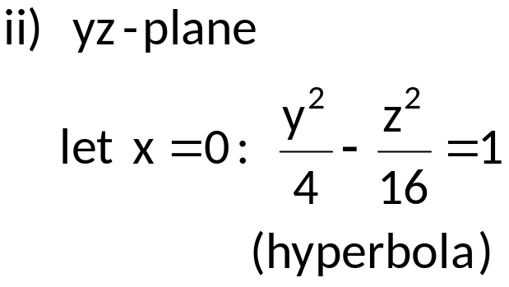

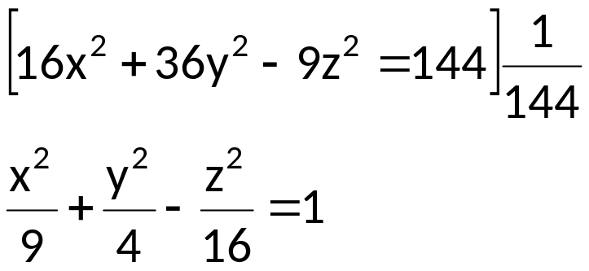
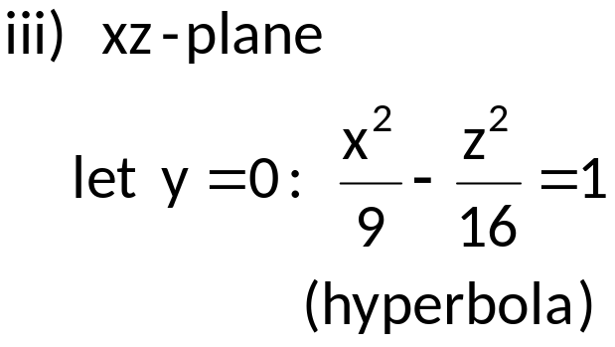
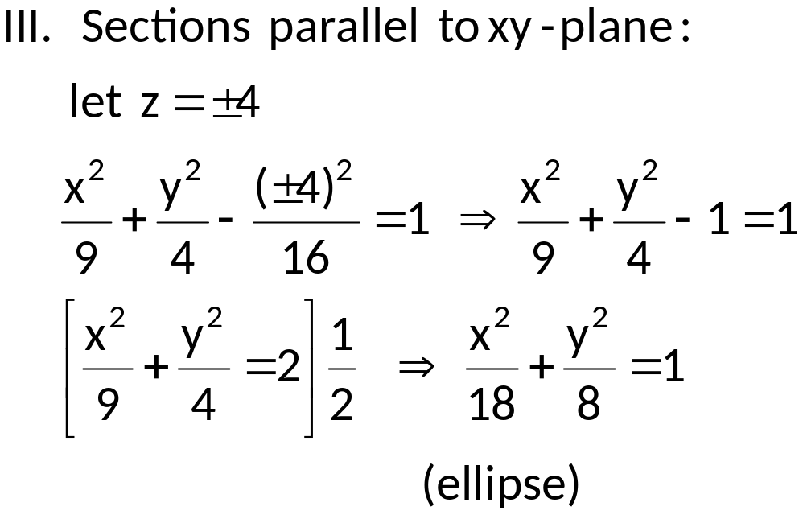
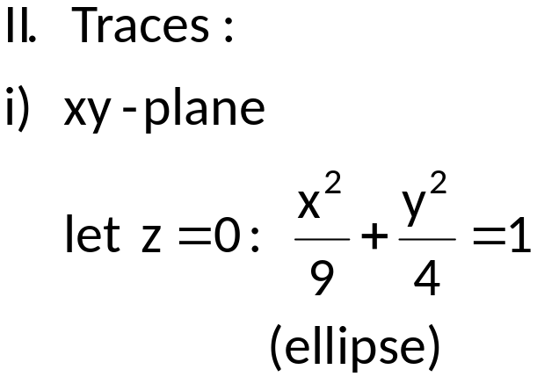
2. 16x²+36y²-9z²=144
 | x | y | z
x | ±3 | 0 | 0
y | 0 | ±2 | 0
z | 0 | 0 | ±4i

Slide 33
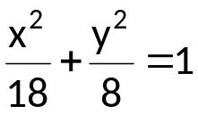
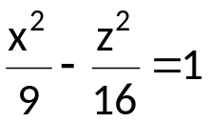


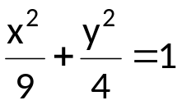
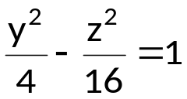
z
(-4.2,0,4)
z=4
(0,-2.8,4)
(0,2.8,4)
y’
(-3,0,0)
(4.2,0,4)
(0,2,0)
y
(0,-2,0)
(-4.2,0,-4)
x’
(3,0,0)
z=-4
y”
(0,-2.8,-4)
(0,2.8,-4)
x
x”
(4.2,0,-4)

Slide 34
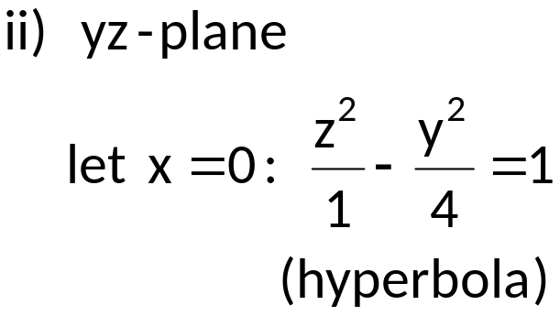
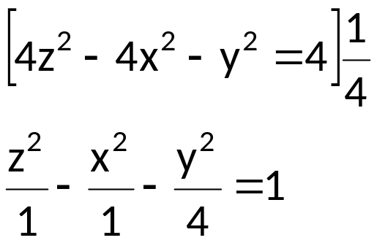

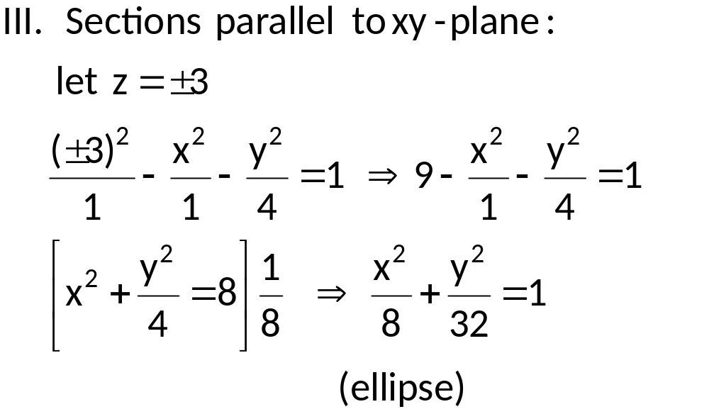
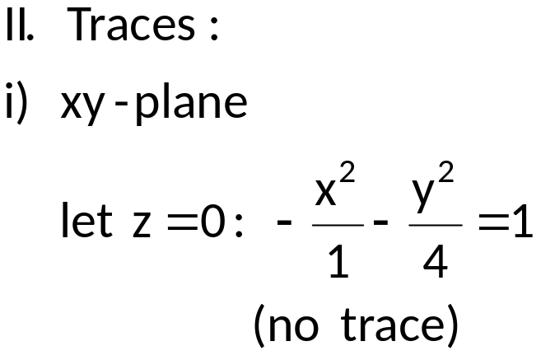
3. 4z²-4x²-y²=4
 | x | y | z
x | ±i | 0 | 0
y | 0 | ±2i | 0
z | 0 | 0 | ±1

Slide 35
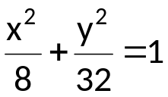

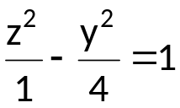
z
(-2.8,0,3)
z=3
(0,-5.7,3)
(0,5.7,3)
y’
(0,0,1)
(2.8,0,3)
y
(-2.8,0,-3)
x’
(0,0,-1)
z=-3
(0,-5.7,-3)
(0,5.7,-3)
y”
x
(2.8,0,-3)
x”

Slide 36
REFERENCES
Analytic Geometry

